Slide 1
Factors Affecting Household Size:
An Analysis of the Philippine Family Income
and
Expenditure Survey
Group 01:
Gillian Parkinson
Zihe Xu
Baoyin Ling (Presenter)
Ying Chen (Presenter)
Yu Shi (Presenter)

Slide 2
01
Introduction
02
Exploratory Data Analysis
CONTENTS
03
Analysis of Covariates
04
Formal Model Analysis
05
Conclusion and Future Work

Slide 3
01
Introduction

Slide 4

Introduction
Background
The size of a household can be influenced by a number of economical, environmental and cultural factors.
Aim
To determine which household related variables influence the number of people living within a household.
Data Information
Triennial Family Income and Expenditure Survey (FIES) recorded in the Cordillera Administrative Region of the Philippines.

Slide 5
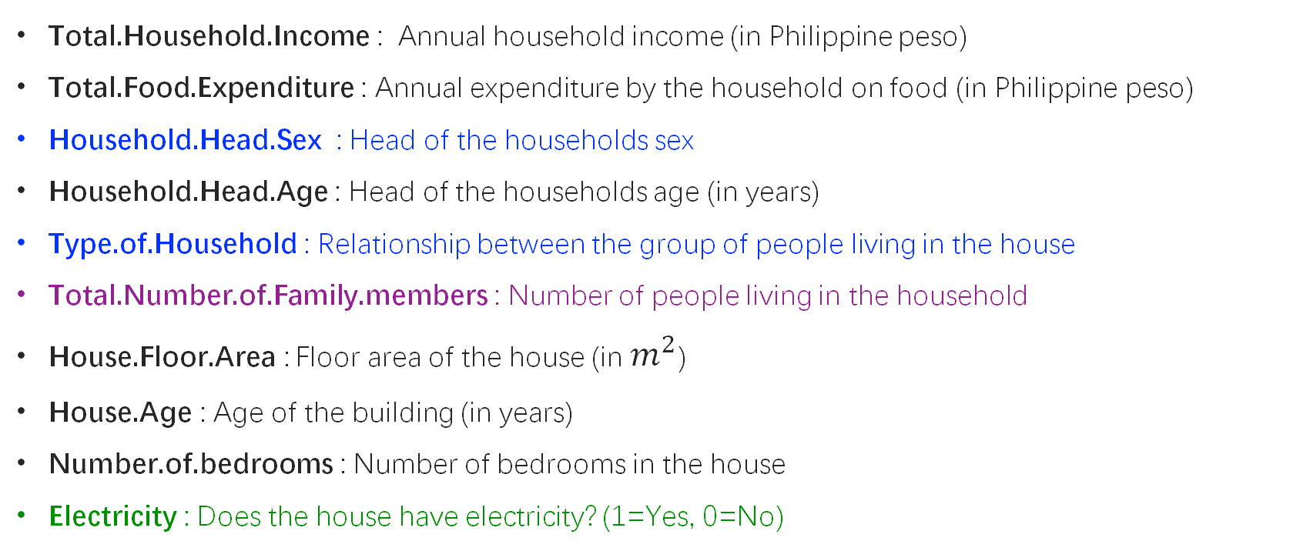
Introduction
1725 observations of 10 variables
Total.Household.Income : Annual household income (in Philippine peso)
Total.Food.Expenditure : Annual expenditure by the household on food (in Philippine peso)
Household.Head.Sex : Head of the households sex
Household.Head.Age : Head of the households age (in years)
Type.of.Household : Relationship between the group of people living in the house
Total.Number.of.Family.members : Number of people living in the household
House.Floor.Area : Floor area of the house (in $m^{2}$)
House.Age : Age of the building (in years)
Number.of.bedrooms : Number of bedrooms in the house
Electricity : Does the house have electricity? (1=Yes, 0=No)
Categorical
Response
Binary

Slide 6
02
Exploratory Data
Analysis

Slide 7
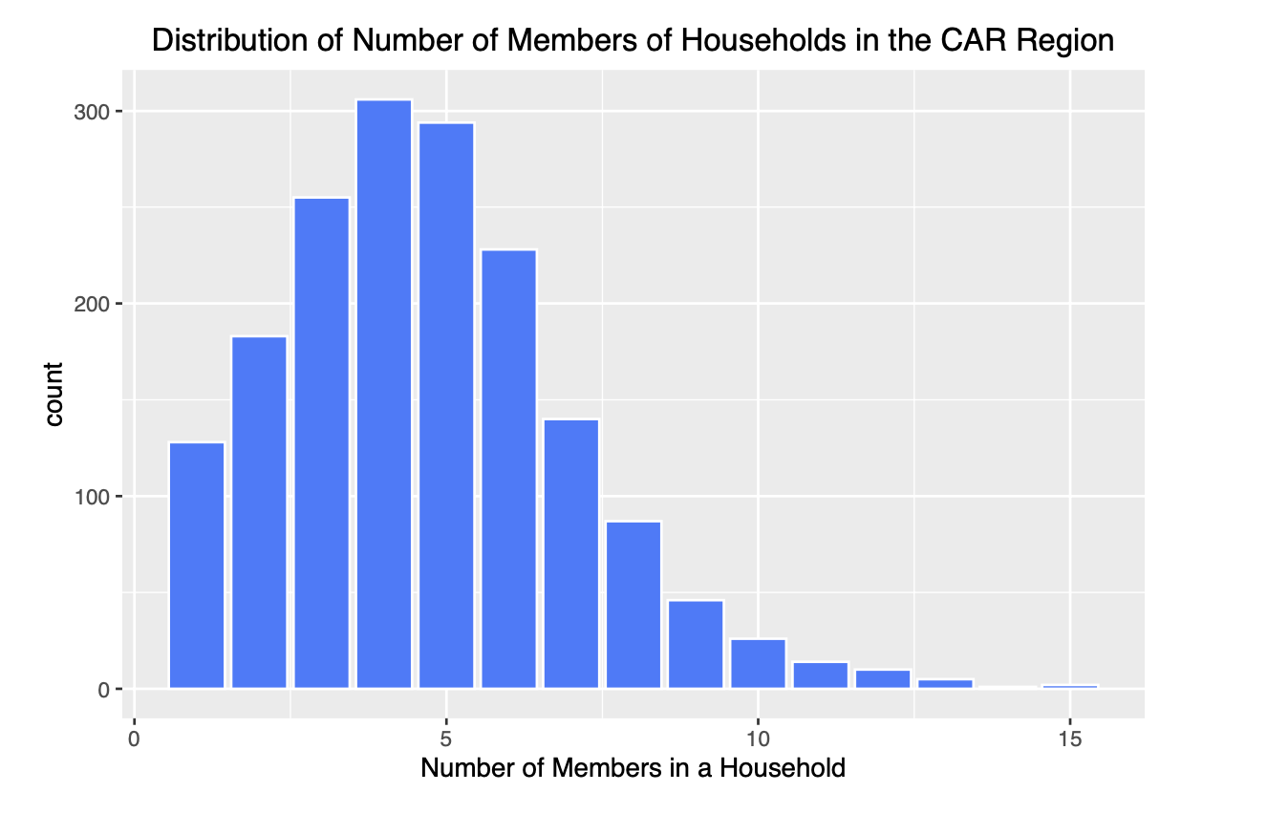
Exploratory Data Analysis
Response Variable
Right-skewed
Most of the family size is between 3-6 people, among which the family with 4 people is the most

Slide 8
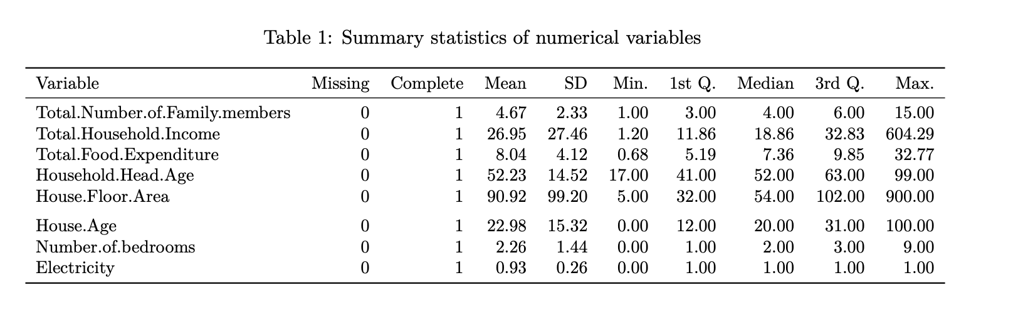
Exploratory Data Analysis
Numerical Variables
Response Variable has mean 4.67 and median 4
Possible outliers of Total Household Income and House Floor Area

Slide 9
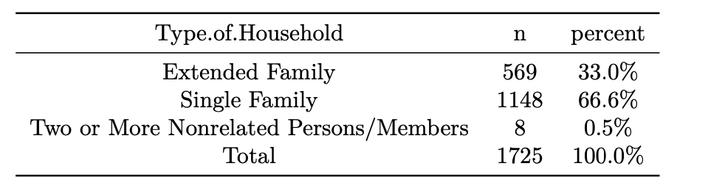
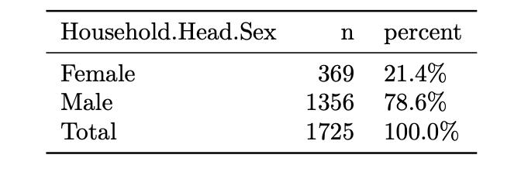
Exploratory Data Analysis
Categorical Variables
Most of the households are formed by
single families
Less than a quarter of households had a female head of household

Slide 10
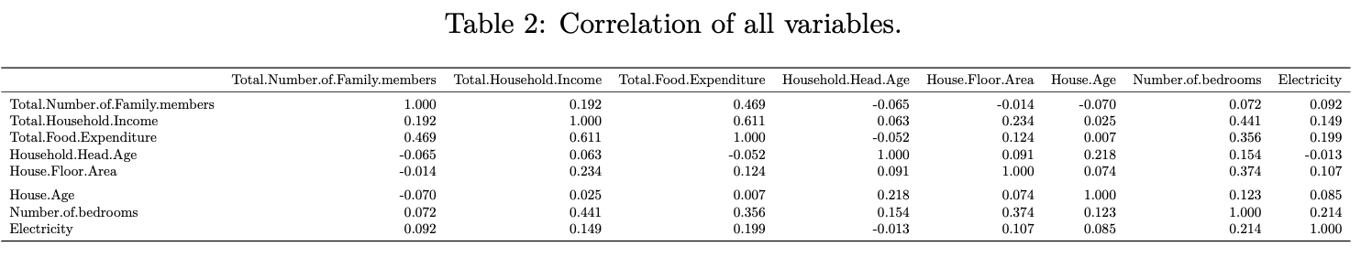
Exploratory Data Analysis
Moderate positive correlation between the total household income and the household food expenditure
Weak positive correlation between the total household income and the number of bedrooms in the household
Weak positive correlation between the number of family members and total food expenditure
The other variables are very weakly correlated

Slide 11
03
Analysis of Covariates

Slide 12
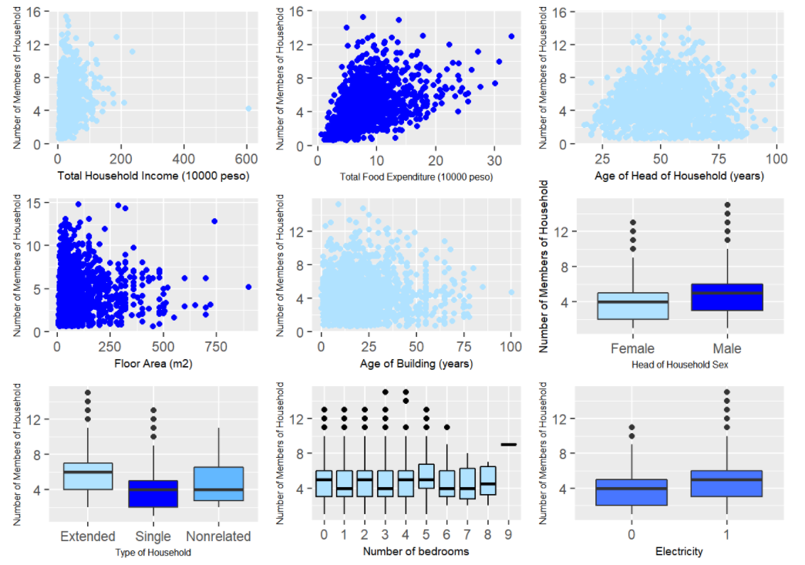
Analysis of Covariates
Total food expenditure, age of the head of household, sex of the head of household and age of the house seem to have a weak effect on the number of people in the household.

Slide 13
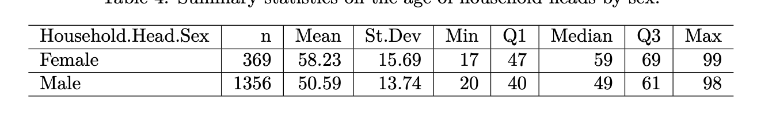
Analysis of Covariates
Household Head Sex & Age
The relationship between gender and age
The mean age of a female household head is older than male.
The minimum and maximum ages of household heads do not appear to differ greatly according to the individuals' sex.

Slide 14
Analysis of Covariates
Income and Expenditure
The fitted model may be being heavily influenced by the extreme values, particularly by one extreme point.
Remove the extreme data and plot the chart again, the scatterplot of total household income against total food expenditure suggests a moderate positive correlation

Slide 15
04
Formal Model
Analysis

Slide 16
Poisson Regression Model
The response variable of the Total Number of Family Members (or members of the household) can be viewed as a count and therefore a Poisson Regression model is considered.
Overdispersion: For a Poisson model to be suitable, the mean and variance should be equal and so these assumptions are checked first. The possibility of over-dispersion in our model is not a significant issue.
Mean | 4.669373
Variance | 5.446049

Slide 17
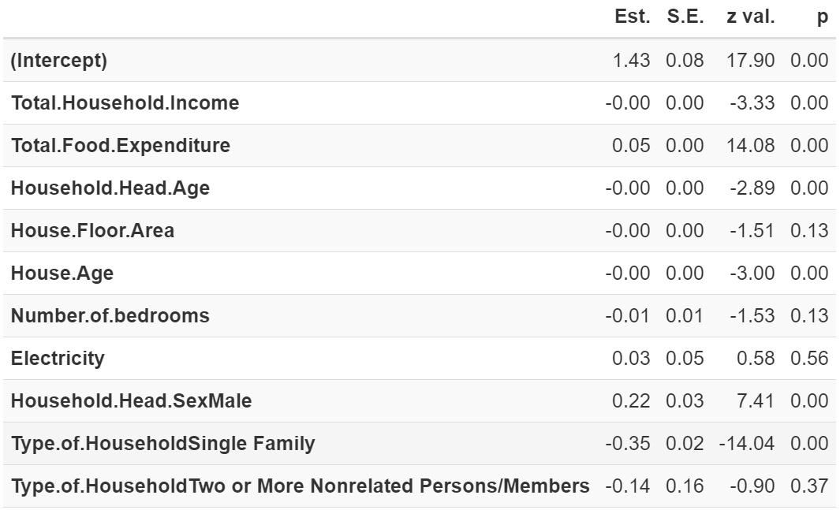
Poisson Regression Model
Now for all the explanatory variables, the results are modelled as follows.
The Poisson model fitted with all possible covariates concludes there are six statistically significant predictors at the 5% level.

Slide 18
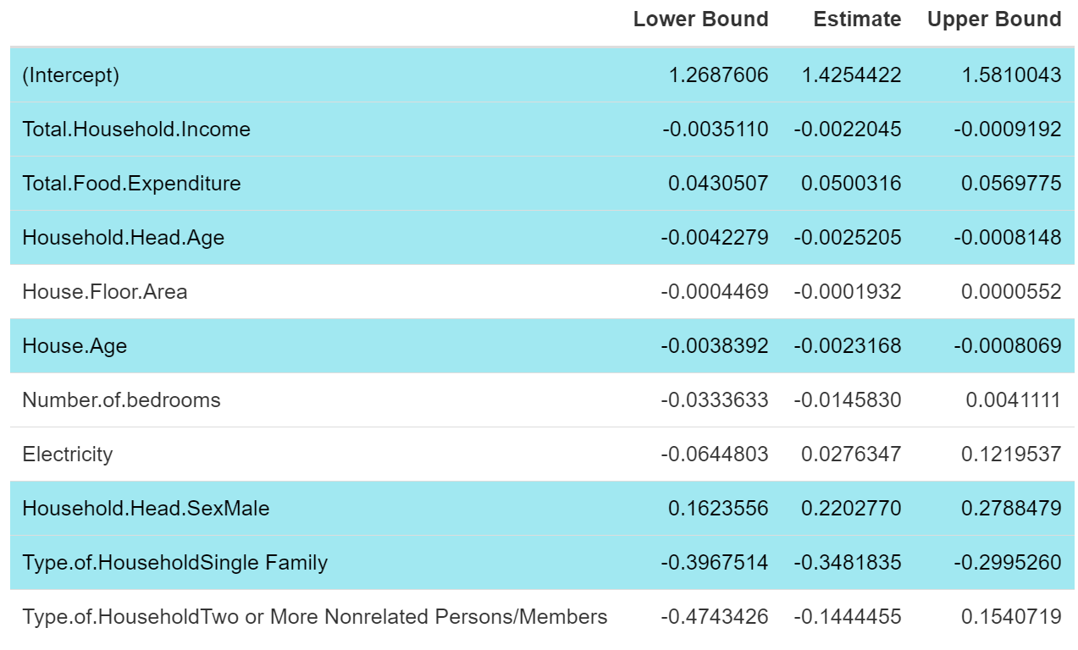
Poisson Regression Model
The confidence intervals for area, number of bedrooms, and electricity include 0.
This indicates that these three variables have no significant effect on the number of people in the household.

Slide 19
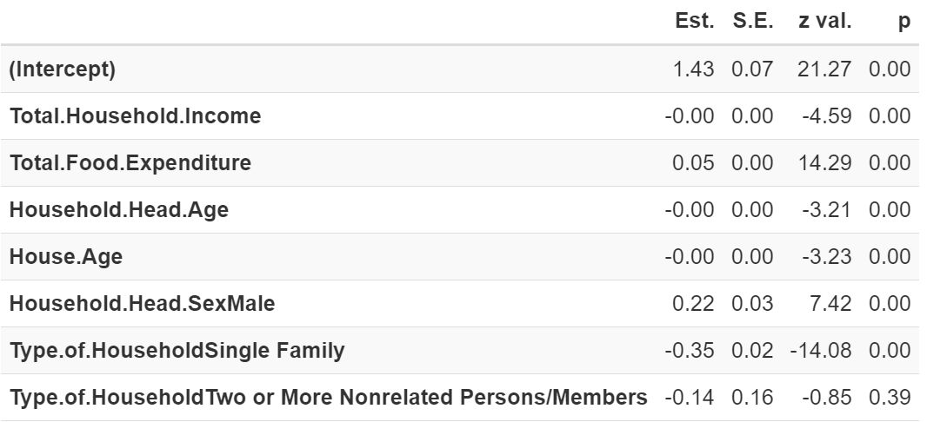
Poisson Regression Model
We refitted the model to include only the previously identified significant variables and again evaluated the 95% confidence intervals for the estimated parameters

Slide 20
Poisson Regression Model
The p-values for total household income, total food expenditure, head of the households age, age of house, and head of the households sex in this model are all less than 0.05. This indicates that these variables are significant for the response variable (household size).

Slide 21
Poisson Regression Model
The baseline family type is an Extended Family
The p-value for a family type of two or more unrelated individuals is greater than 0.05.
Households composed of a single family (p value <0.05) is a statistically significant predictor for the number of members of a household.

Slide 22
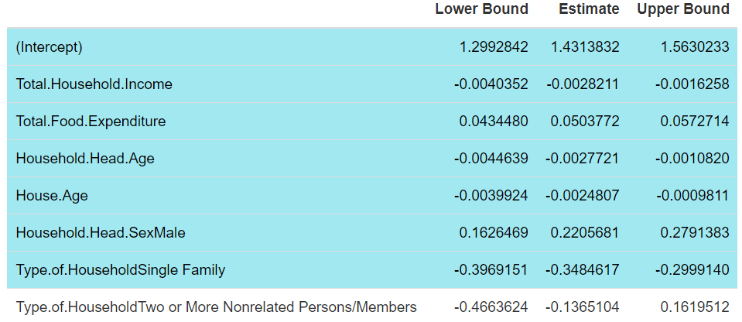
Poisson Regression Model
95% Confidence Intervals
The confidence intervals identify the same significant predictors as the p-values for the estimated parameters.

Slide 23
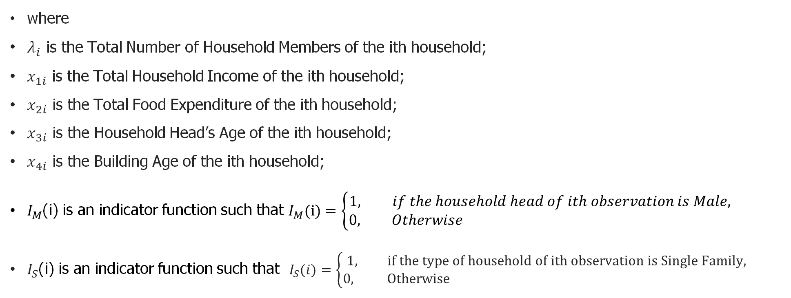
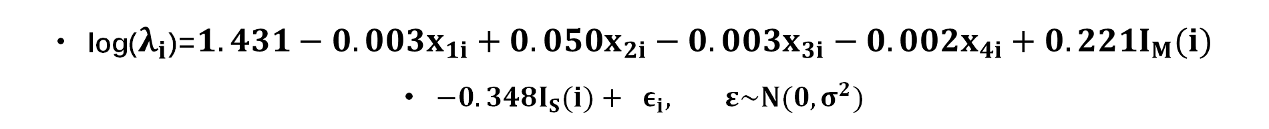
Poisson Regression Model
log($λ_{i}$)=$1.431−0.003x_{1i}+0.050x_{2i}−0.003x_{3i}−0.002x_{4i}+0.221I_{M}(i)$
$−0.348I_{S}(i)+ ε_{i}, ε\sim N(0,σ^{2})$
where
$λ_{i}$ is the Total Number of Household Members of the ith household;
$x_{1i}$ is the Total Household Income of the ith household;
$x_{2i}$ is the Total Food Expenditure of the ith household;
$x_{3i}$ is the Household Head’s Age of the ith household;
$x_{4i}$ is the Building Age of the ith household;
$I_{M}$(i) is an indicator function such that $I_{M}(i)=\left\{\begin{aligned}1, if the household head of ith observation is Male, \\ 0, Otherwise \end{aligned}\right.$
$I_{S}$(i) is an indicator function such that $I_{S}(i)=\left\{\begin{aligned}1, if the type of household of ith observation is Single Family, \\ 0, Otherwise \end{aligned}\right.$

Slide 24
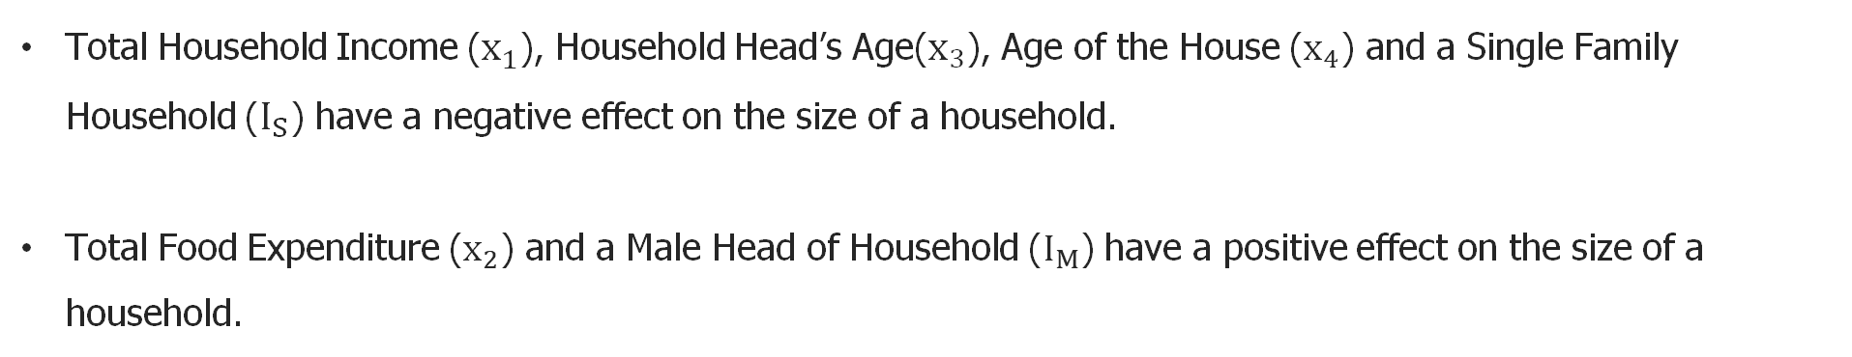
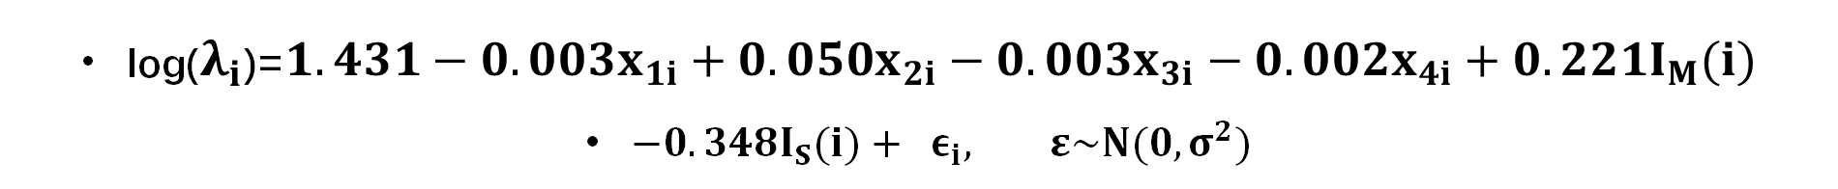
Poisson Regression Model
log($λ_{i}$)=$1.431−0.003x_{1i}+0.050x_{2i}−0.003x_{3i}−0.002x_{4i}+0.221I_{M}(i)$
$−0.348I_{S}(i)+ ε_{i}, ε\sim N(0,σ^{2})$
Total Household Income ($x_{1}$), Household Head’s Age($x_{3}$), Age of the House ($x_{4}$) and a Single Family Household ($I_{S}$) have a negative effect on the size of a household.
Total Food Expenditure ($x_{2}$) and a Male Head of Household ($I_{M}$) have a positive effect on the size of a household.

Slide 25
Conclusions
and
Future Work
05

Slide 26
Conclusion
Combining the p-values and confidence intervals, we conclude the following variables significantly influence the number of members in a household:
Total Household Income
Total Food Expenditure
Head of Household Age
Head of Household Sex
Age of the House
Single or Extended Family Household

Slide 27
Future Work
Correlation between explanatory variables suggest that there may be multicollinearity present.
Detect multicollinearity and removing related variables could improve our model.
Including interactions between explanatory variables may also improve the model.

Slide 28
Thank You For Watching

